Slide 1
Project CV Creating a Real-Time Face Detection and Object Recognition System in Pygame using MobileNet and Face Cascade
Ravuri Naga Lakshmi Chittitalli

Slide 2
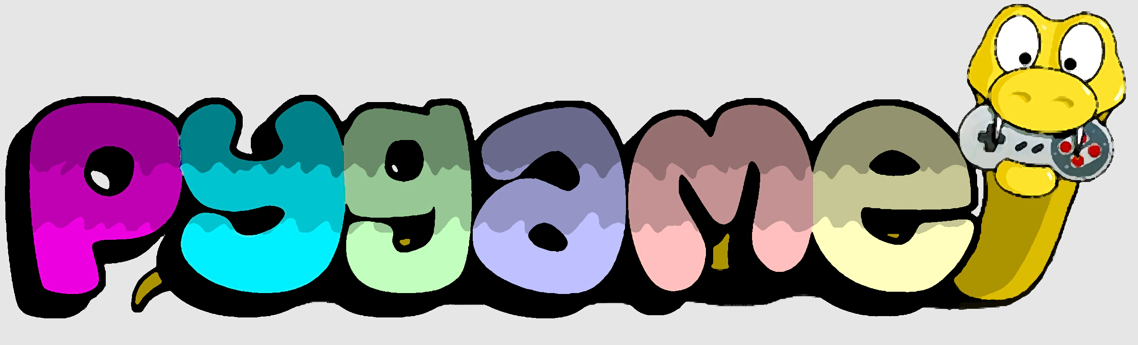
Pygame
Pygame is a popular Python module that is used for building 2D games and multimedia applications.
A start screen is shown until the user presses the spacebar to start the game.
Object detection: If the predicted object is in the list of objects to detect, the program increases the score.
Face recognition: Based on face movements, the program moves the player's avatar (blue) on the screen.
The player gains points based on how many enemy avatars (red) he escapes.
If the player's avatar goes out of bounds, the game ends, and the final score is displayed.
The user can restart the game by pressing the 'r' key or quit the game by pressing the 'q' key.

Slide 3
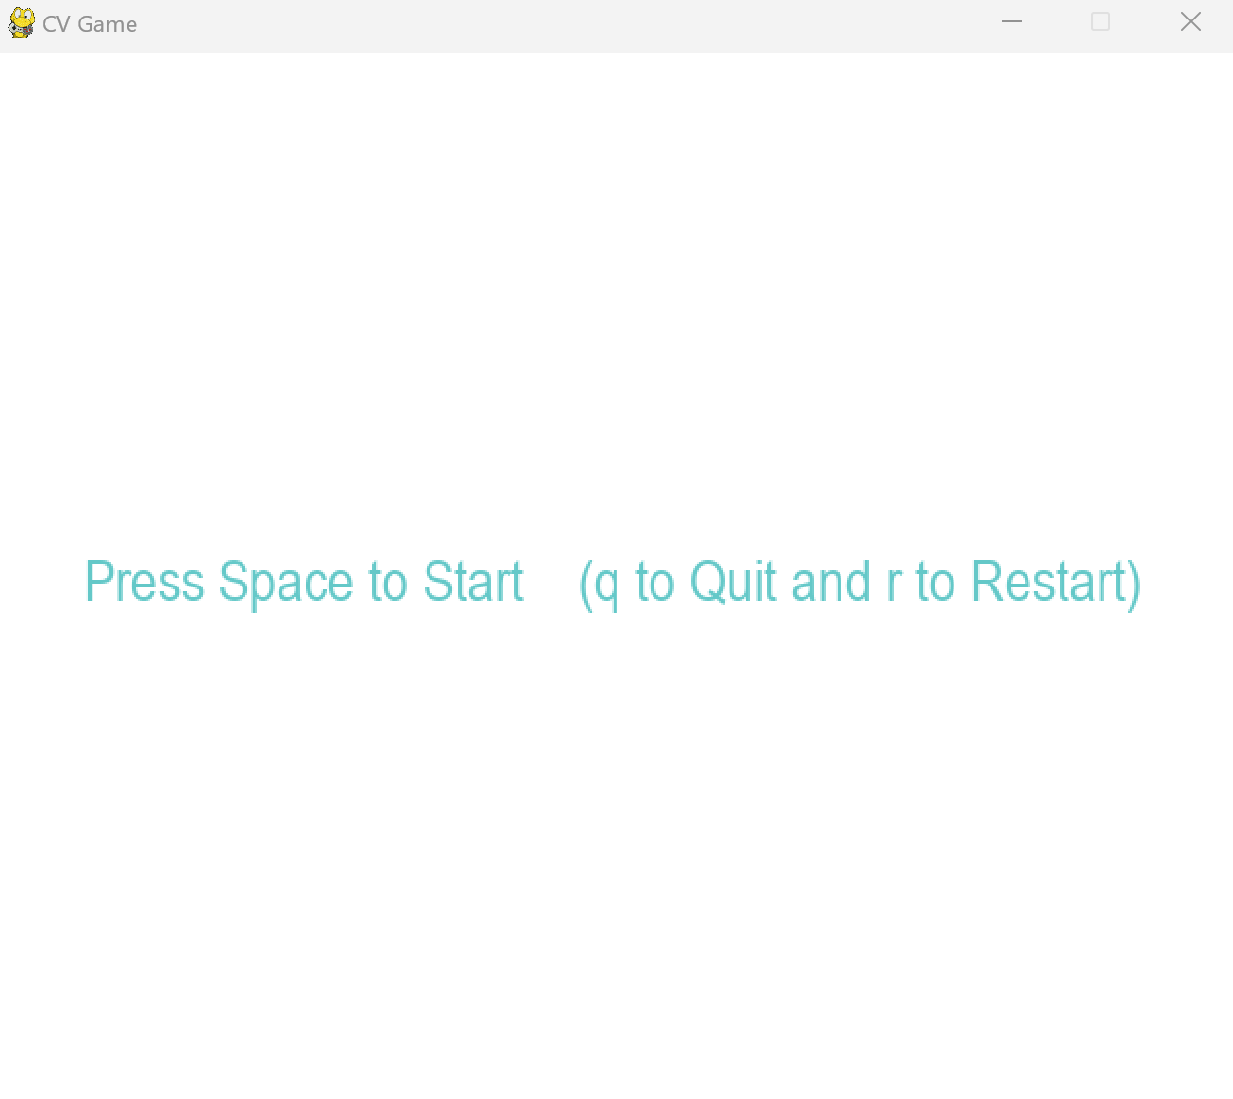
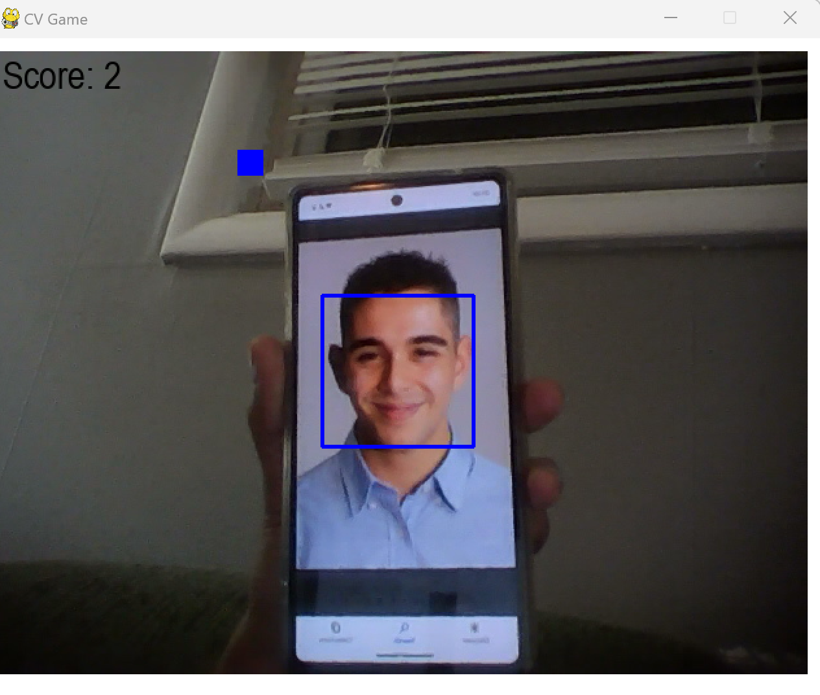
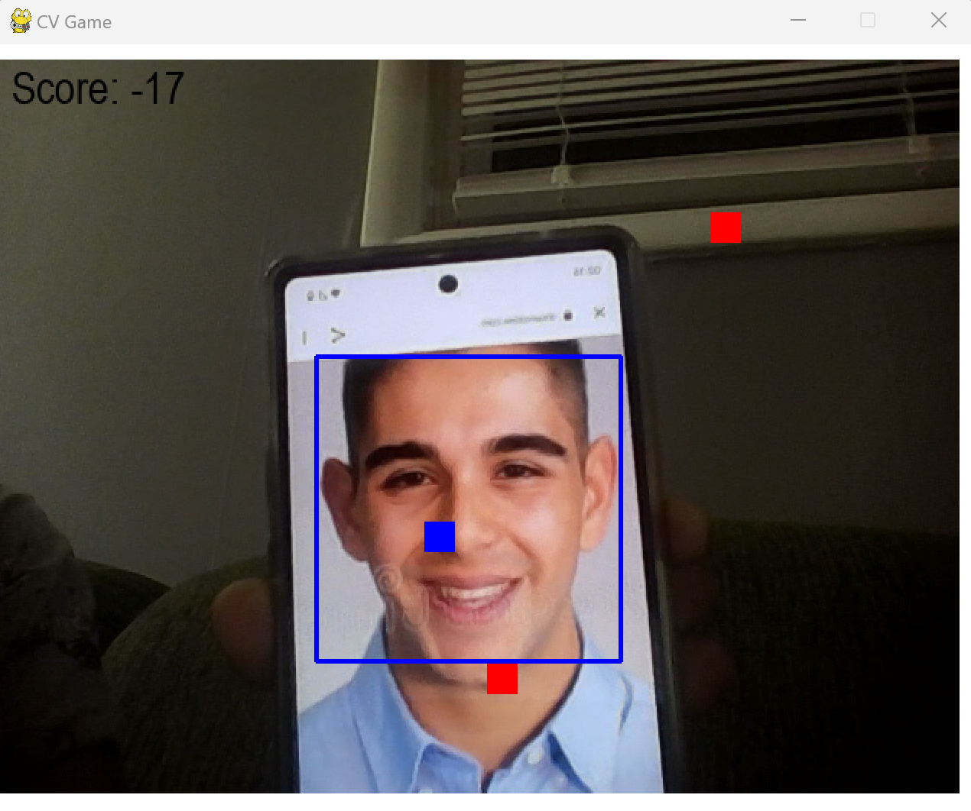
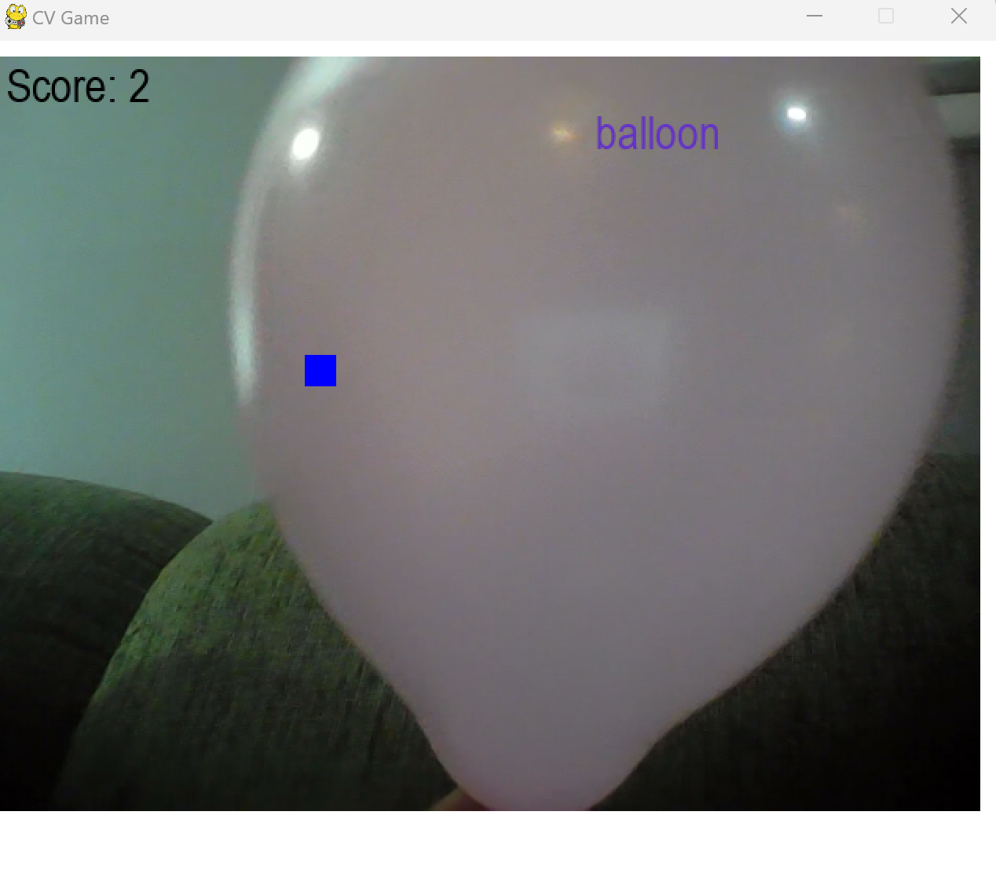
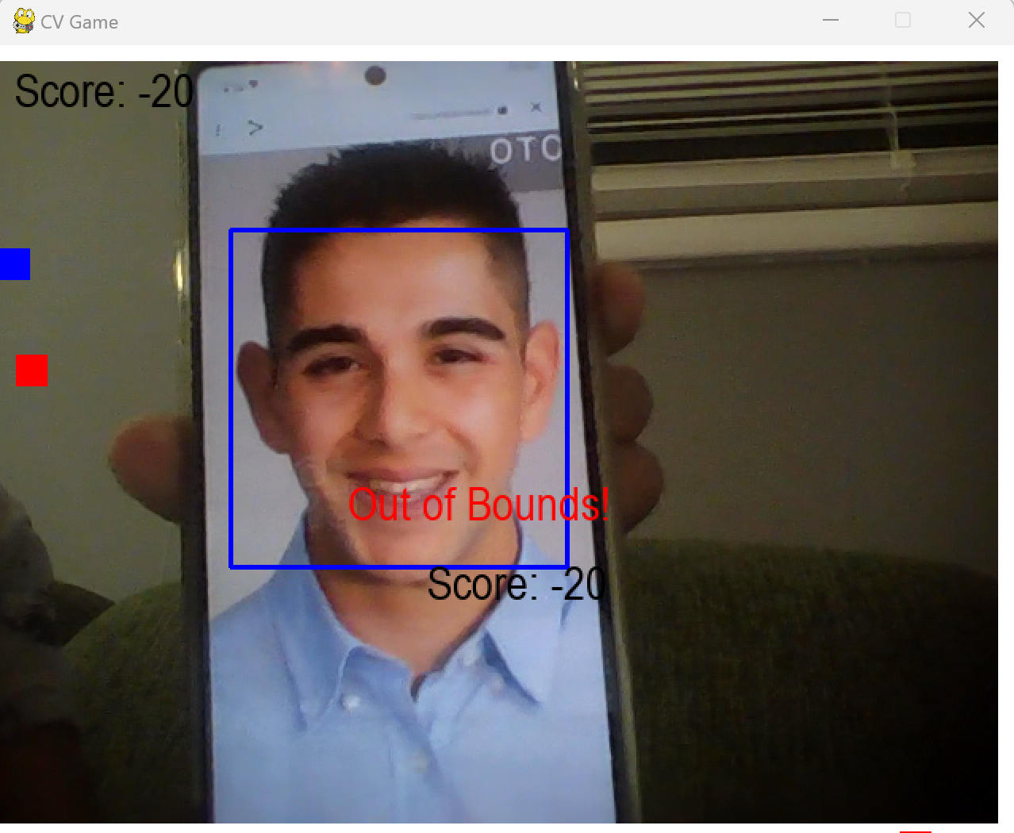
How does the game work?

Slide 4
Libraries used in the given code:
cv2: OpenCV library is used to detect the faces in the captured frame from the webcam and for image processing.
numpy: NumPy is a library used for numerical computations in Python. Here, it is used for numerical operations on arrays and for manipulating images.
tensorflow: TensorFlow is an open-source library used for building and training machine learning models. In this code, it is used to load the pre-trained model MobileNetV2.
pygame: Pygame is a set of Python modules used for building games. In this code, it is used to set up the game window, game loop, and handle events.

Slide 5

From Pre-trained Models to Custom Solutions: The Benefits of Transfer Learning
Transfer learning is a technique in machine learning where a pre-trained model is used as a starting point for a new model. Instead of training a new model from scratch.
Instead of training a new model from scratch, the pre-trained model's knowledge is transferred to the new model, which is then fine-tuned for a specific task.
Transfer learning is often used when the task at hand has limited data, and a pre-trained model can help improve performance.
In the provided code, transfer learning is used to classify objects detected by a webcam using the pre-trained MobileNetV2 model.

Slide 6
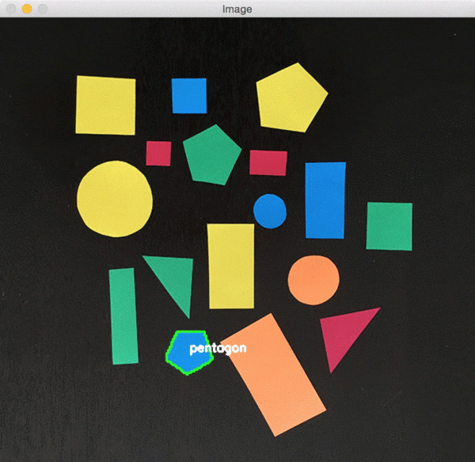
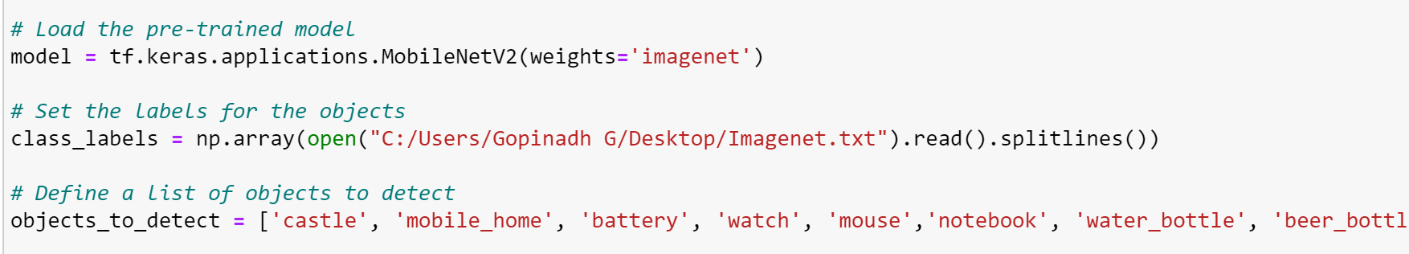
Real-time Object Detection using MobileNetV2 and ImageNet
Object detection is a computer vision technique used to locate and classify objects within an image or video stream.
Object detection is performed using a pre-trained MobileNetV2 model from TensorFlow, which is trained on the ImageNet dataset.
The ImageNet dataset provides the class labels for the objects to detect.
The detected object's class name is displayed on the Pygame window if it matches any of the objects to detect in the defined list.

Slide 7

Face Detection and Real-time Face-tracking using OpenCV and Webcam
The code uses a library called OpenCV to find faces in images.
OpenCV uses a special technique called the Haar Cascade Classifier to find faces.
The Haar Cascade Classifier is trained on many pictures of faces so it knows what a face looks like.
The code uses a webcam to capture video of the user's face.
OpenCV checks each frame of the video for faces and draws a rectangle around any faces it finds.
The code then calculates the center of the face and moves a player (a rectangle) on the screen based on the position of the face.
The result is that the player follows the user's face as they move in front of the webcam.

Slide 8

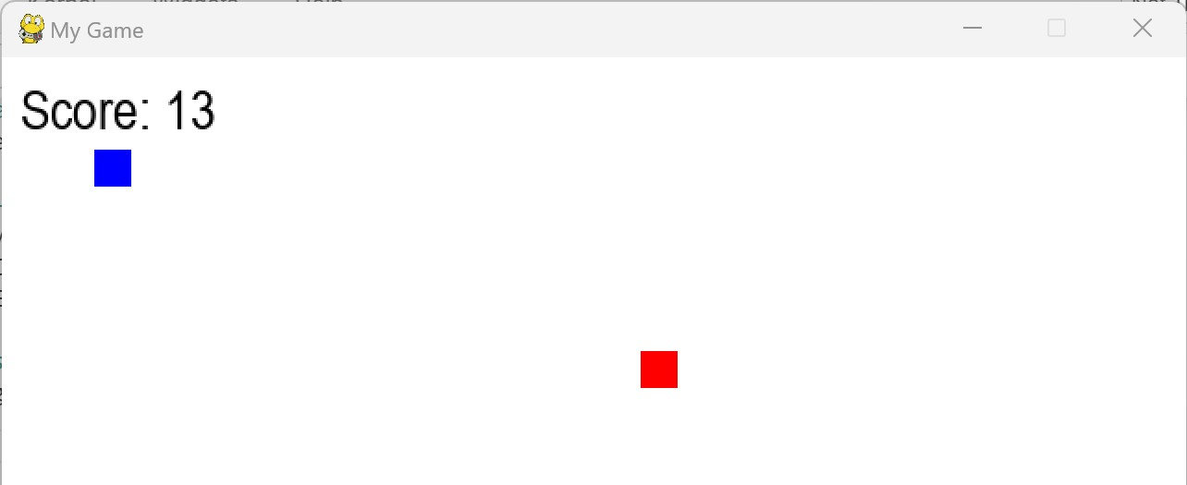
Points, Collision, and Restart
The player receives points for correctly identifying objects that match a predefined list of objects.
The score is updated every time the player correctly identifies an object.
If the player’s avatar and enemies avatar collides, player loses points
The player get points, as they escape from enemies
If the player goes out of bounds, the game ends and the final score is displayed.
Whenever you click space the game starts, and q for quit the game and r for restart

Slide 9
In this project, we used computer vision and machine learning techniques to create an interactive game where the player moves a character using face gestures and collects objects recognized by a pre-trained model.
We utilized OpenCV for face detection, TensorFlow and Keras to load a pre-trained MobileNetV2 model, and Pygame for game development, including handling events and displaying graphics and text.
Exploring the Potential of Computer Vision and Machine Learning for Creating Real-Time Interactive Applications: A Simple Game Example
Overall, this project showcases the potential of combining different technologies to create real-time applications that can recognize and respond to user input.

Slide 10
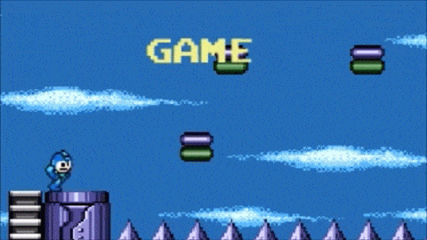
Thank you

